Slide 1
Hormone
A hormone is any member of a class of signaling molecules, produced by glands in multicellular organisms, that are transported by the circulatory system to target distant organs to regulate physiology and behavior. Hormones have diverse chemical structures, mainly of three classes:
*eicosanoids
*steroids & *amino acid/protein derivatives (amines, peptides, and proteins)

Slide 2
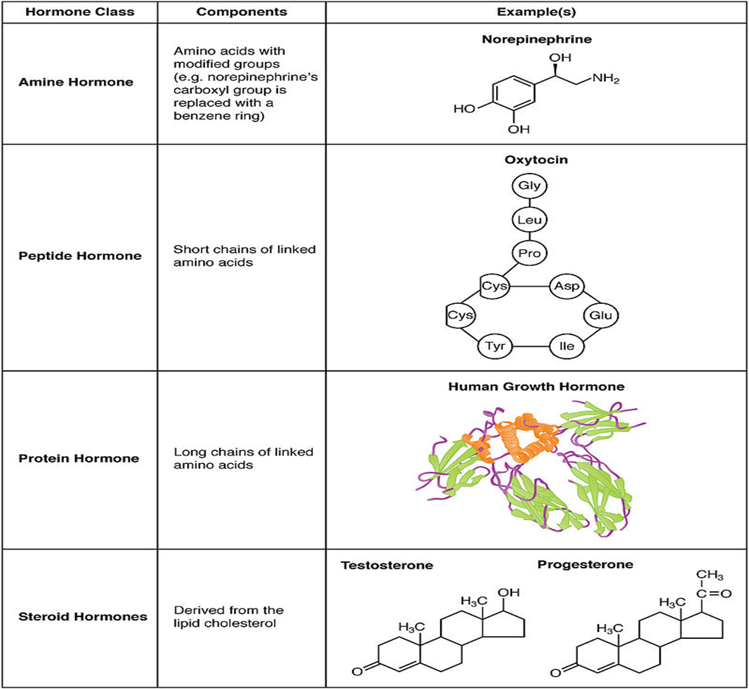

Slide 3
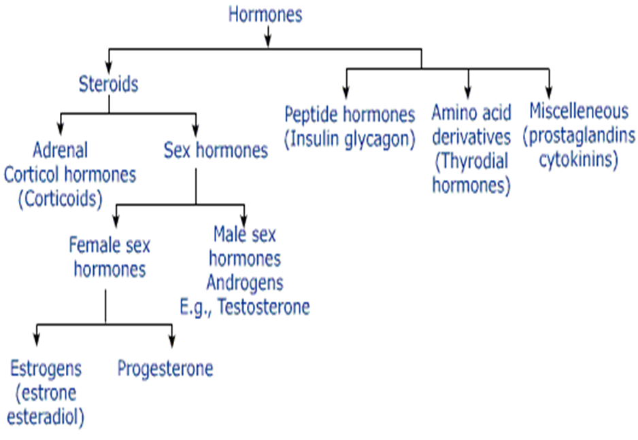

Slide 4
Endocrine glands
1. Hypothalamus
2. Pituitary
3. Epiphysis
4. Thymus
5. Thyroid gland
6. Parathyroid glands
7. Langergans’ islands of pancreas
8. Epinephrine glands
9. Sex glands

Slide 5
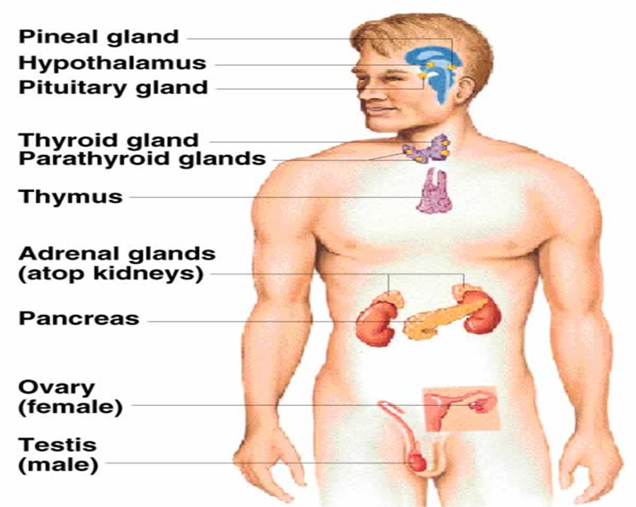

Slide 6
Classification of hormones according to chemical nature
*Proteins: hormones of anterior pituitary (except ACTH), insulin, parathyroid hormone.
*Peptides: ACTH, calcitonin, glucagon, vasopressin, oxytocin, hormones of hypothalamus (releasing factors and statins).
*Derivatives of amino acids: catecholamins (epinephrine and norepinephrine), thyroxin, triiodthyronin, hormones of epiphysis.
*Steroid (derivatives of cholesterol): hormones of the cortex of epinephrine lands, sex hormones.
*Derivatives of polyunsaturated fatty (arachidonic) acids: prostaglandins.

Slide 7
Fate of hormones in the organism
*Are secreted directly into the blood
*Peptide and protein hormones are secreted by exocytosis
*Steroid (lipophilic) hormones continuously penetrate the membrane (they are not accumulated in cells, their concentration in blood is determined by the speed of synthesis)

Slide 9
